Slide 1
Digital Signatures
Homework 6

Slide 2
Communication Over the Internet
What type of guarantees do we want?
Confidentiality
Message secrecy
Data integrity
Message consistency
Authentication
Identity confirmation
Authorization
Specifying access rights to resources

Slide 3
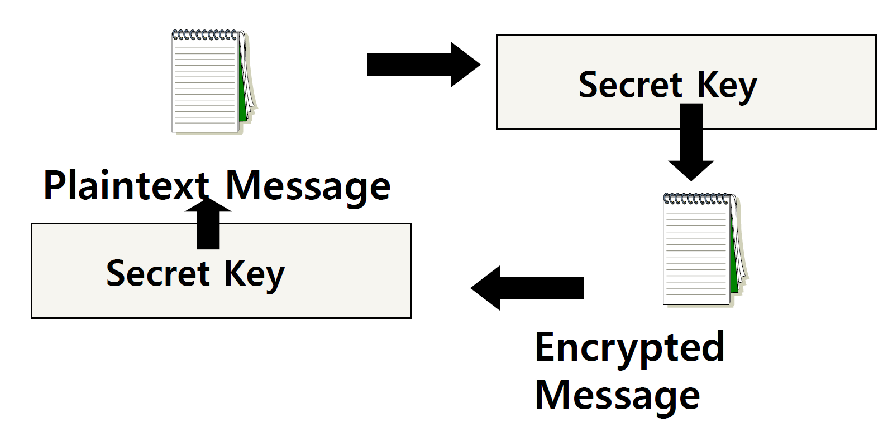
Secret Key (symmetric) Cryptography
A single key is used to both encrypt and decrypt a message

Slide 4
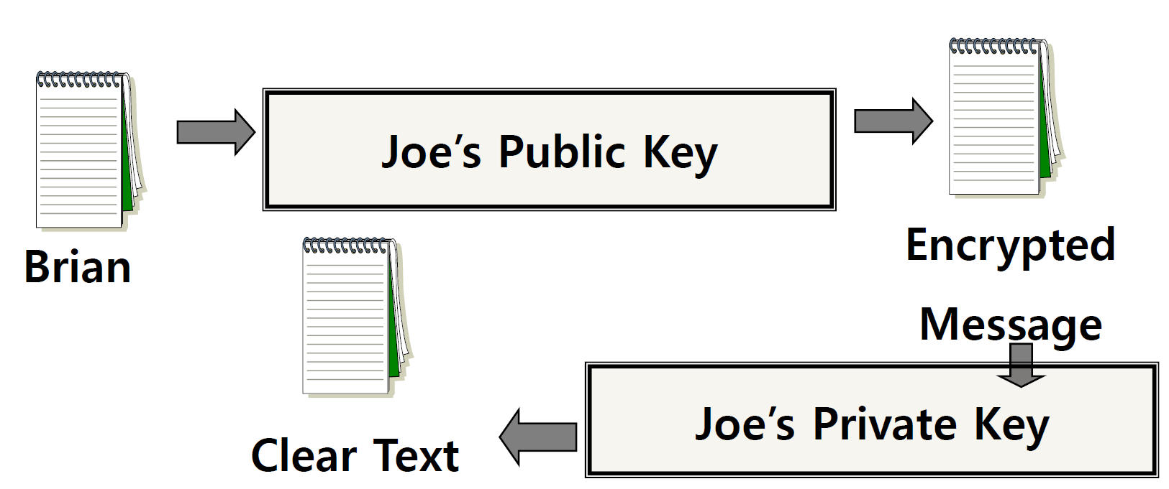
Public Key (asymmetric) Cryptography
Two keys are used: a public and a private key. If a message is encrypted with one key, it has to be decrypted with the other.

Slide 5
Digital Signature
An electronic stamp or seal
Is appended to a document
Ensures data integrity
document was not changed during transmission

Slide 6
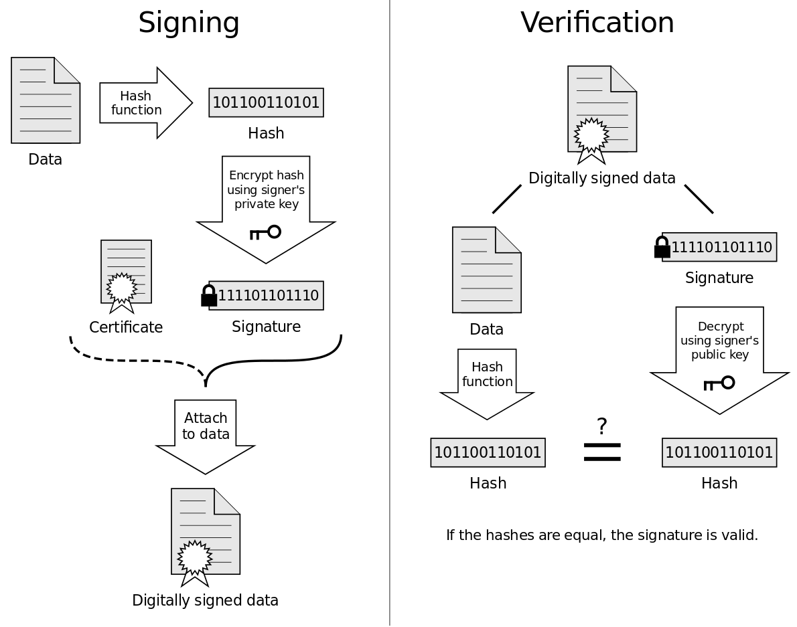

Slide 7
Steps for Generating a Digital Signature
SENDER:
Generate a Message Digest
The message digest is generated using a set of hashing algorithms
A message digest is a 'summary' of the message we are going to transmit
Even the slightest change in the message produces a different digest
Create a Digital Signature
The message digest is encrypted using the sender's private key. The resulting encrypted message digest is the digital signature
Attach digital signature to message and send to receiver

Slide 8
Steps for Generating a Digital Signature
RECEIVER:
Recover the Message Digest
Decrypt the digital signature using the sender’s public key to obtain the message digest generated by the sender
Generate the Message Digest
Use the same message digest algorithm used by the sender to generate a message digest of the received message
Compare digests (the one sent by the sender as a digital signature, and the one generated by the receiver)
If they are not exactly the same => the message has been tampered with by a third party
We can be sure that the digital signature was sent by the sender (and not by a malicious user) because only the sender's public key can decrypt the digital signature and that public key is proven to be the sender’s through the certificate. If decrypting using the public key renders a faulty message digest, this means that either the message or the message digest are not exactly what the sender sent.

Slide 9
Detached Signature
Digital signatures can either be attached to the message or detached
A detached signature is stored and transmitted separately from the message it signs
Commonly used to validate software distributed in compressed tar files
You can't sign such a file internally without altering its contents, so the signature is created in a separate file

Slide 10
Homework 6
Answer 2 questions in the file hw.txt
Generate a key pair with the GNU Privacy Guard’s commands
$ gpg --gen-key (choose default options)
Export public key, in ASCII format, into hw-pubkey.asc
$ gpg --armor --output hw-pubkey.asc --export ‘Your Name’
Make a tarball of the above files + log.txt and zip it with gzip to produce hw.tar.gz
$ tar –cf hw.tar <files>
$ gzip hw.tar -> creates hw.tar.gz
Use the private key you created to make a detached clear signature hw.tar.gz.sig for hw.tar.gz
$ gpg --armor --output hw.tar.gz.sig --detach-sign hw.tar.gz
Use given commands to verify signature and file formatting

